Slide 1
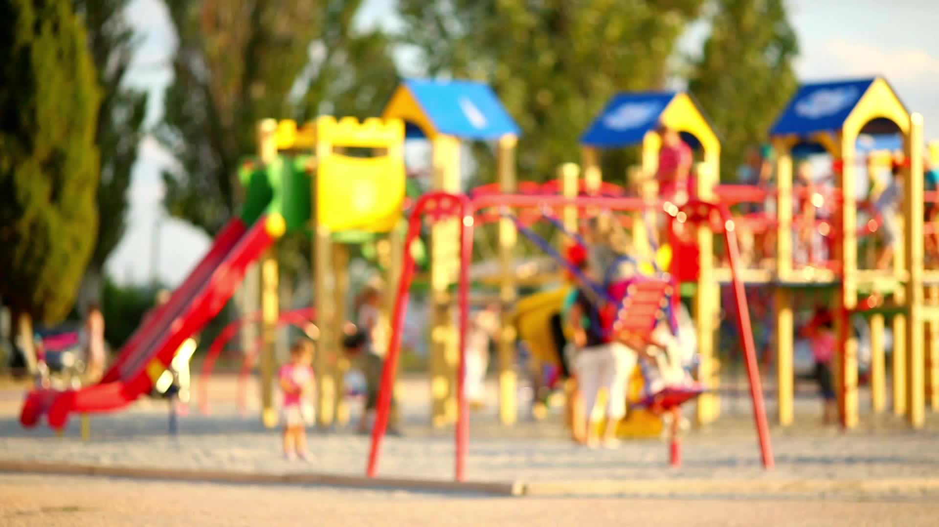
Wereham Play Area A contractor w/c 8 July will be applying sealant to the flooring and when complete will it be closed for a couple days werehampc@gmail.com 07795006811

